Slide 1
EMOTIONAL ABUSE IN MARRIAGES
A PRESENTATION DONE BY MRS NDUAGUBA CHINONYE ANGELA

Slide 2

What is emotional abuse?
It is also known as psychological abuse, it is a pattern of behavior where one person intentionally harms or controls another person's emotional well being

Slide 3
FORMS OF EMOTIONAL ABUSE
VERBAL ABUSE
GASLIGHTING
EMOTIONAL MANIPULATIONS
ISOLATIONS
BELITTING
THREATS
CONSTANT CRITICISMS
CONTROL

Slide 4
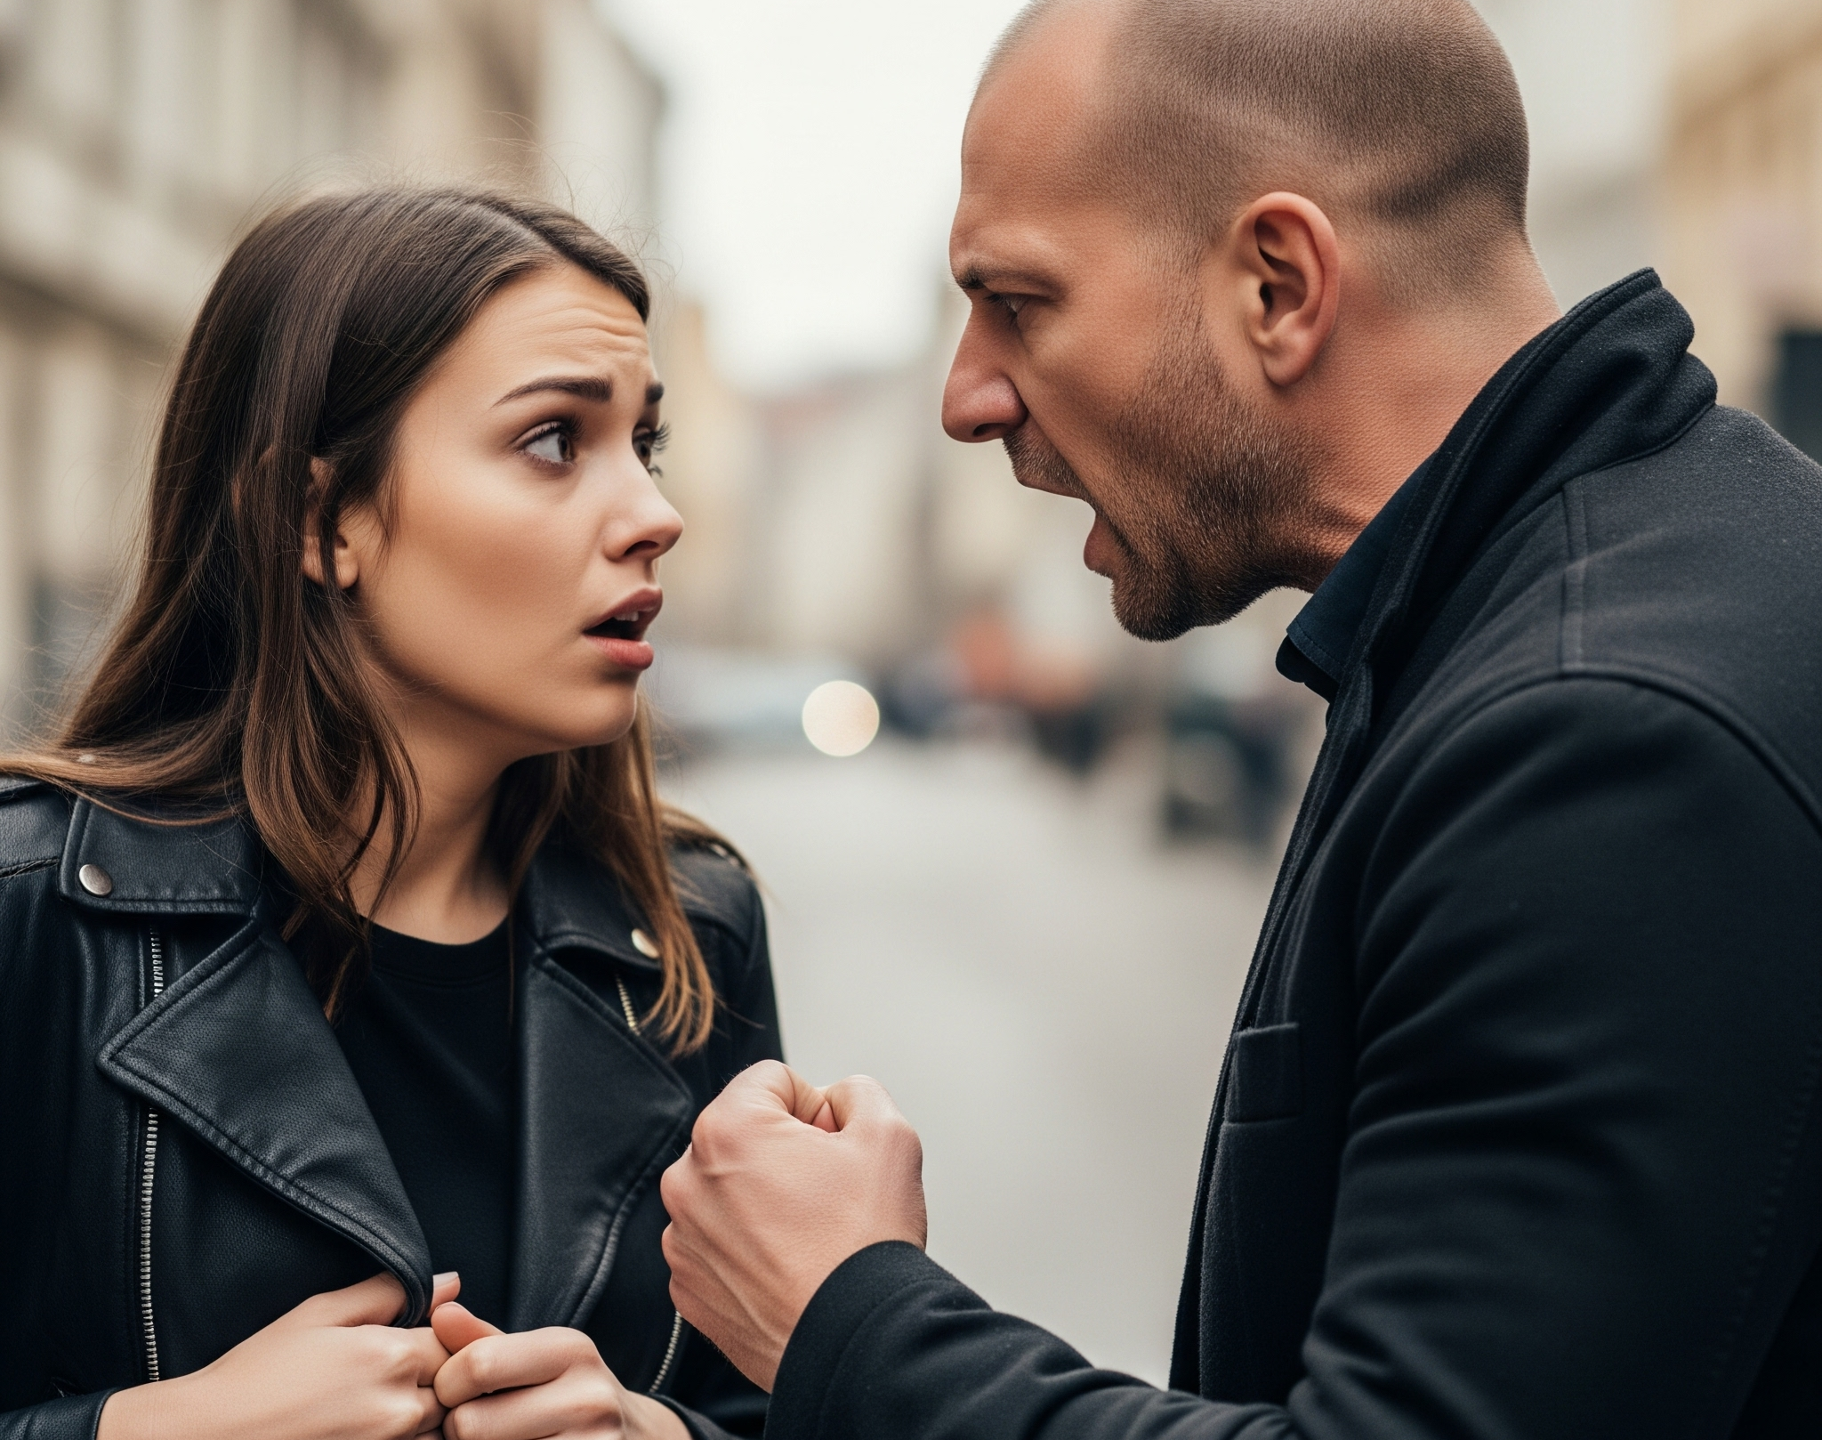
VERBAL ABUSE
For example, name calling, insults, put-downs or humiliations

Slide 5
GASLIGHTING
This is a form of psychological manipulation where a person makes someone question their own sanity, memory or perception , the term originates from the 1938 play and 1944 film “gaslight” where a husband tries to drive his wife insane by manipulating her perception or reality
Examples of gaslighting
Denying previous agreements or conversations – I never said that
Blaming the victim –you are too sensitive
Minimizing trivializing – it's just a joke
Projecting – you are the one who is always doing that
Manipulating information – this never happened

Slide 6
EMOTIONAL MANIPULATION
This is the act of using guilt , anger or self pity to control some one’s behavior .
ISOLATION
Isolating someone from friends , family or social activities .
BELITTING:
Minimizing someone's feelings , accomplishments or contributions .
THREATS:
Threatening to harm oneself or others if the person does not comply with the demands

Slide 7
CONSTANT CRITICISM:
Constantly criticizing someone’s appearance , behavior or decision .
CONTROL:
Dictating what the partner can or cannot do , making your partner feel responsible for your emotions –you always make me feel so unhappy.
EMOTIONAL BLACKMAIL:
Threatening self harm or consequences , if you don’t do this , I will leave you
LOVE WITHDRAWAL:
With holding affection or intimacy –”I am not talking to you until you apologize.”
Making your partner feel unworthy of love –”you are not good enough for me “,
“I regret the day I met you”, “what pushed me to you”.

Slide 8
PLAYING THE VICTIM:
Portraying themselves as the victim- “you are always picking on me “
DOWNPLAYING HURTFUL BEHAVIOUR
It was just a joke
Denying hurtful behavior- “I never did that”
SHIFTING BLAME :
“You are the one who is causing problem in our relationship”

Slide 9
EFFECTS OF EMOTIONAL ABUSE
Emotional abuse in marriages can have severe and long-lasting effects on a person’s mental and emotional well-being .some potential effects include.
Low self esteem : constant criticism and belittling can erode a person's confidence and self worth
Anxiety and depression: emotional abuse can lead to feeling of fear , anxiety and depression.
Trauma: Emotional abuse can be traumatic leading to symptoms post traumatic stress disorder (PSTD)
Emotional numbness: some people may become emotionally numb as a coping mechanism
sucidial thoughts

Slide 10
PYSCHOLOGICAL EFFECT
Chronic stress – headache
Sleep disturbance
Insomnia or nightmares

Slide 11
How to stop emotional abuse in marriage
Dont negotiate: stop believing their words, dont ignore yourself.
identify the cycle of abuse behaviour
draw the line then you will see changes
it is never your fault -you can make mistakes but not all the time
some things are beyound your control
stop encouraging your abuser by not retaliating.
have a support structure , get people who can stand with you and help whenever the need occurs (marriage sponsor or councillor)

Slide 12
love yourself - never stop living or caring for yourself, pay attention to your needs and try to meet them . give yourself that priority.
keep your health first , do not ignore your physical and mental health.
dont follow your partners words. think for a while and see if you are actually at fault . Believe your own observation.
communicate effectively- ensure you communicate your feelings to your spouse . encourage them to open up too.
Remain confident -show your confidence and communicate ,if you are comfortable with how your partner is treating you .
Get help, Get professional help-marriage counsellors, priest.
surround yourself with positive people and good people.prefer the company of positive and strong people.
walk away

Slide 13
Causes of emotional abuse in marriage
anger management issues.
jealousy, suspicious
low self esteem
feeling inferior
cultural belief- they have the right to control their partner
learned behaviour from growning up in a family where domestic violence was accepted
alcohol and drugs abuse
history of abuse -history of being abused can make individuals more likely to become abuses themselves, repeating a cycle of trauma.

